Slide 1
Graphing Linear Inequalities 8th or 9th Grade Algebra
Lisa Over

Slide 2
Big Idea
Connect prior knowledge of graphing inequalities and linear equations to graphing linear inequalities
Compare and contrast linear inequalities where the direction of the inequality and/or the sign of the slope differ (Hands-on activity)
Develop a procedure to determine what portion of the graph to shade

Slide 3
Objectives
Students will be able to …
Correctly graph and solve linear inequalities in two variables 8 out of 10 times.
Correctly demonstrate an understanding of the vocabulary linear inequality and solution of a linear inequality 8 out of 10 times.

Slide 4
PA State Standards
Anchor Descriptor - A1.1.3.2 Write, solve and/or graph systems of linear inequalities using various methods.
Eligible Content - A1.1.3.2.1 Write and/or solve a system of linear inequalities using graphing (limit systems to 2 linear inequalities).

Slide 5
Common Core Standards
CC.2.2.HS.D.7 - Create and graph equations or inequalities to describe numbers or relationships.
CC.2.2.HS.D.9 - Use reasoning to solve equations and justify the solution method.
CC.2.2.HS.D.10 - Represent, solve, and interpret equations/inequalities and systems of equations/inequalities algebraically and graphically.

Slide 6
Rationale for Students
Present various real-life scenarios to students so they connect what they will learn in this lesson to real-life.
The German club is having a bake sale and needs to raise $250. If they sell German chocolate cupcakes for $3.00 each and packs of two Pfeffernuesse cookies for $2.00 each, how many of each do they need to sell to raise at least $250?
Jacqueline wants to spend no more than $37 while stocking up on ice cream and chocolate sauce. Ice cream costs $5 per carton and chocolate sauce costs $2 per jar. What combinations of each can she buy without exceeding her budget of $37?

Slide 7
Materials
1 smart board and computer with lesson files
1 copy: Graphing Linear Inequalities Pattern Activity (teacher’s version)
24 copies: Graphing Linear Inequalities Pattern Activity Worksheet
Colored Pencils
12 copies: Graphing Linear Inequalities Partnership Solution Worksheet OR iPad/laptop
24 copies: Graphing Linear Inequalities Homework Choice Board

Slide 8
Differentiation
Students create a visual reference of the pattern of shading four basic linear inequalities.
Students work in pairs meeting the following criteria:
Two different ability levels are represented within each partnership
The ability levels of each student in any partnership are not so extremely different to inhibit the learning of either or both students
Homework consists of a choice board from which students select problems to accumulate 25 points.

Slide 9
Technology
Smart board
iPad/laptop with drawing application (optional)

Slide 10
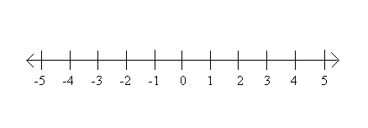
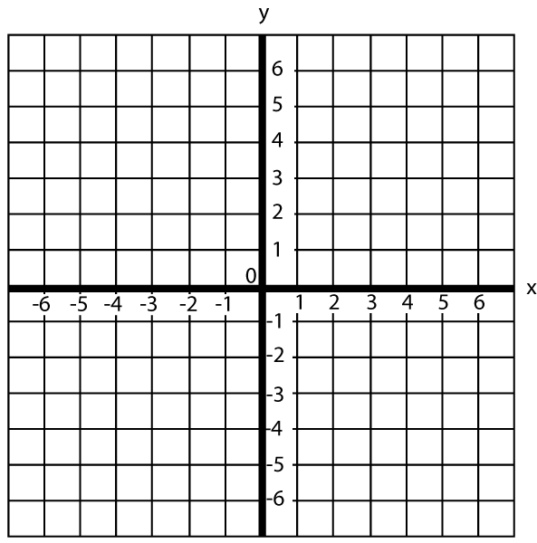
Anticipatory Set
Activate prior knowledge
Graphing inequalities on a number line
Graphing linear equations
Graph the inequalities
x ≤ 4
x > -2
Graph the linear equations
y = x + 4
y = -2x - 3

Slide 11
Procedure: Instruction and Activity
Connect the new concept to student’s prior knowledge of graphing inequalities and of graphing linear equations.
Create a visual reference and develop a procedure that will support them when graphing independently.
Illustrate examples of more complex linear inequalities.

Slide 12
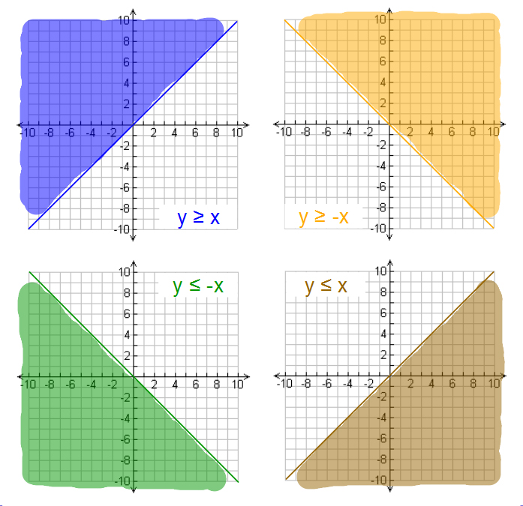

Slide 13
Procedure: Collaborative Group Work
Students work in heterogeneous pairs to…
Solve a linear inequality on a large paper with a coordinate plane or on a computer drawing application.
Outline the steps and decision process they took to solve the inequality.
Teacher circulates during this group work to encourage students and to guide and/or redirect.

Slide 14
Exit Activity
Each group takes a turn to pin the work on the board and to explain their process and solution to the class.
If students use technology to create an image, students add their work to a shared presentation file.
If time is an issue, new groups of 4-6 students can provide a way for multiple students to share simultaneously.

Slide 15
Homework
Several problems in the form of a choice board
Problems are either 3 points, 5 points, or 7 points, depending on the level of difficulty.
Students select problems to accumulate 25 points.
Students will have to select at least two moderate or one hard problem.
Basic – 6 problems worth 3 points
Moderate – 4 problems worth 5 points
Hard – 4 problems worth 7 points

